Slide 1
The Vocation of Citizen
Christianity lived through Politics

Slide 2
OBEY!
Romans 13

Slide 3
DISOBEY!
Acts 5

Slide 4
So which is it?
Matthew 22:21
Romans 13:5-7
1 Timothy 2:1-3
Titus 3:1
1 Peter 2:13-14

Slide 5
5 minute break

Slide 6
Wisdom & Discernment
Occasions of Christian Civil Disobedience

Slide 7
Trajan Decius (ruled 249-251)
To the Commissioners of Sacrifice of the Village of Alexander’s Island:
From Aurelius Diogenes, the son of Satabus, of the Village of Alexander’s Island, aged 72 years: ---scar on his right eyebrow.
I have always sacrificed regularly to the gods, and now, in your presence, in accordance with the edict, I have done sacrifice, and poured the drink offering, and tasted of the sacrifices, and I request you to certify the same. Farewell.
-----Handed in by me, Aurelius Diogenes.
-----I certify that I saw him sacrificing [signature obliterated].
Done in the first year of the Emperor, Caesar Gaius Messius Quintus Trajanus Decius Pius Felix Augustus, second of the month Epith. [June 26, 250 A.D.]
William Stearns Davis, ed. Readings in Ancient History: Illustrative Extracts from the Sources, 2 Vols. (Boston: Allyn and Bacon, 1912-1913), Vol. II: Rome and the West, p. 289.

Slide 8
Acts & Monuments (John Foxe, 1587)
Fabian, Bishop of Rome
Julian of Cilicia was put into a leather bag filled with serpents and scorpions and thrown into the sea.
Peter was killed for refusing to sacrifice to Venus (who was a bit of a harlot as far as gods went). The Proconsul was so upset he had Peter stretched upon a wheel, breaking all his bones. Then he was beheaded.
Nichomachus was tortured on the rack. He recanted his Christianity and then immediately fell to the ground and died.
Denisa, a sixteen year old woman, was beheaded for confessing Christ.
Andrew and Paul were stoned to death.
Alexander and Epimachus were beaten with sticks, torn with hooks, and then burnt in the fire. Four young women were martyred on the same day in the same place by way of beheading.
Lucian and Marcian were pagan magicians (wizards) who converted to Christianity and were burnt alive for not renouncing Christianity.
Trypho and Respicius were pierced with nails, dragged through the streets, scourged, torn with hooks, scorched with lit torches, and then beheaded.

Slide 9
Acts & Monuments (John Foxe, 1587)
Agatha was a beautiful woman who was desired by Governor Quintian of Sicily. She refused to marry him and so he made her work in a brothel but she would not do it. When Quintian found out that Agatha was also a Christian, he had her scourged, burnt with red hot irons and torn with sharp hooks. Then to humiliate the pious virgin, he laid her naked on burning coals mixed with glass. She died while they were carrying her back to prison.
Cyril, bishop of Gortyna, at 84 years old refused to burn incense to the gods. He walked himself to the place of execution and was martyred.
Decius came to Antioch, whose bishop was Babylas. Babylas refused to let the emperor enter in. When he was commanded to offer sacrifice to pagan gods and refused, he was thrown in prison, loaded with chains, beaten, and then beheaded. Him also with three young men who had been studying under him to become pastors.
Alexander, bishop of Jerusalem, was thrown in prison for refusing to burn incense and died there.
Julianus and Cronion were bound on the back of camels, scourged, and then thrown into a fire. There were also forty Christian virgins who refused to renounce the faith that were burned on that day.
In 251 Emperor Decius built a temple at Ephesus and commanded all there to sacrifice to the idols. Maximianus, Martianus, Joannes, Malchus, Dionysius, Sarion, and Constantinus – who were all soldiers under decius – refused to make sacrifices. They were able to escape and hide themselves in a cave. When Decius found out about this, he had the mouth of the cave closed and they all died of hunger.
Theodora, another beautiful young Christian, was placed in a brothel. Didymus, a Christian, disguised himself as a soldier and went in to the brothel, dressed her in her clothes, and had her escape. When a “patron” of the brothel found Didymus there, he was taken away, confessed the faith, and was sentenced to death. Theodora threw herself at the judge’s feet begging for mercy, but the judge condemned them both. They were beheaded and then their headless bodies were burnt.
Secundianus, was being carried off to prison for being a Christian. On the way, Verianus and Marcellinus said, "Where are you carrying the innocent?" Their question caused them to be arrested as well. All three were tortured, hanged, and then beheaded.

Slide 10
“Most of the errors which crept into the Church at this time arose from placing human reason in competition with revelation; but the fallacy of such arguments being proved by the most able divines, the opinions they had created vanished away like the stars before the sun.”
John Foxe (1587)

Slide 11
The Protestant Reformation
“Here I Stand”
16th Century

Slide 12
Exsurge Domine (1520)
With the advice and consent of these our venerable brothers, with mature deliberation on each and every one of the above theses, and by the authority of almighty God, the blessed Apostles Peter and Paul, and our own authority, we condemn, reprobate, and reject completely each of these theses or errors as either heretical, scandalous, false, offensive to pious ears or seductive of simple minds, and against Catholic truth. By listing them, we decree and declare that all the faithful of both sexes must regard them as condemned, reprobated, and rejected ... We restrain all in the virtue of holy obedience and under the penalty of an automatic major excommunication
. . .
[W]e likewise condemn, reprobate, and reject completely the books and all the writings and sermons of the said Martin, whether in Latin or any other language, containing the said errors or any one of them; and we wish them to be regarded as utterly condemned, reprobated, and rejected. We forbid each and every one of the faithful of either sex, in virtue of holy obedience and under the above penalties to be incurred automatically, to read, assert, preach, praise, print, publish, or defend them. ... Indeed immediately after the publication of this letter these works, wherever they may be, shall be sought out carefully by the ordinaries and others [ecclesiastics and regulars], and under each and every one of the above penalties shall be burned publicly and solemnly in the presence of the clerics and people.[10]
Notes:
Wikipedia

Slide 13
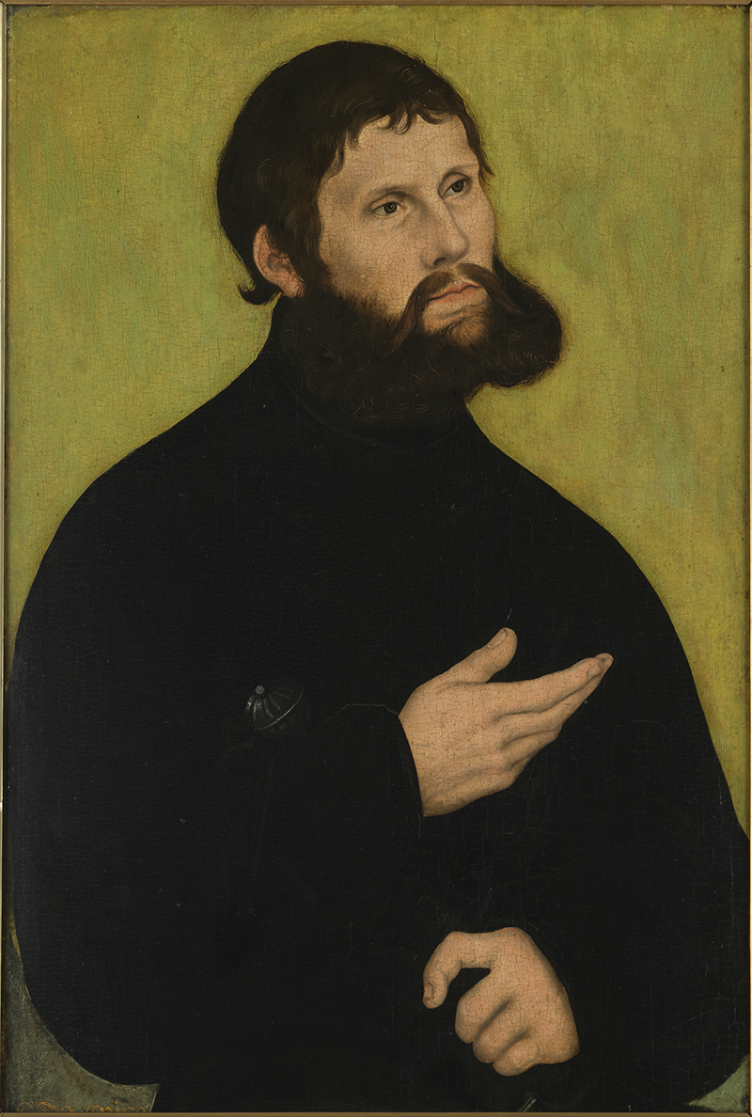
Junker Jörg (1521)
Notes:
https://lucascranach.org/index.php/Home/luther/portrait-2

Slide 14
The Third Reich
Caesar above all
1933-1945

Slide 15
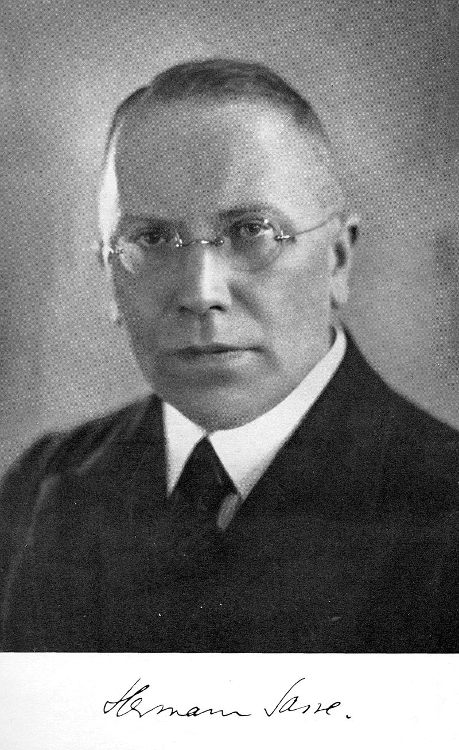
Herman Sasse (1895-1976)
Notes:
Wikipedia

Slide 16
Wisdom and Discernment in Our Own Day

Slide 17

Jack Phillips Masterpiece Cakeshop Lakewood, Colorado

Slide 18
Quiz time!

