Slide 1
Hagio[graphic?] Pedagogy
Fitting AC and AP XXI into the Classroom
Rev. Jacob H. Benson
Luther Classical College

Slide 2
Horace
Ars Poetics
“If a painter should wish to unite a horse's neck to a human head, and spread a variety of plumage over limbs [of different animals] taken from every part [of nature], so that what is a beautiful woman in the upper part terminates unsightly in an ugly fish below; could you, my friends, refrain from laughter, were you admitted to such a sight? Believe, ye Pisos, the book will be perfectly like such a picture, the ideas of which, like a sick man's dreams, are all vain and fictitious: so that neither head nor foot can correspond to any one form. "Poets and painters [you will say] have ever had equal authority for attempting anything." We are conscious of this, and this privilege we demand and allow in turn: but not to such a degree, that the tame should associate with the savage; nor that serpents should be coupled with birds, lambs with tigers

Slide 3
If a preacher should wish to unite a martyr’s neck to a virgin’s head, and spread a variety of miracles and virtues and manliness taken from every part of history – Christian or otherwise – , so that what is a beautiful woman in the upper part terminates in a ridiculous episode from fantasy literature below, could you, my friends, refrain from laughter, when you read such an account? Believe, ye Lutherans, the life of the Christian will be perfectly like such a hagiography, the ideas of which, like a sick man’s dreams, are all vain and fictitious: so that neither head nor foot can correspond to any one individual Christian. “Preachers & hagiographers,” you will say, “have ever had equal authority for attempting such things.” We are conscious of this, and this privilege we demand and allow in turn: but not to such a degree, that the tame should associate with the savage; nor that virgins should be coupled with priests, angels with dragons.”

Slide 4
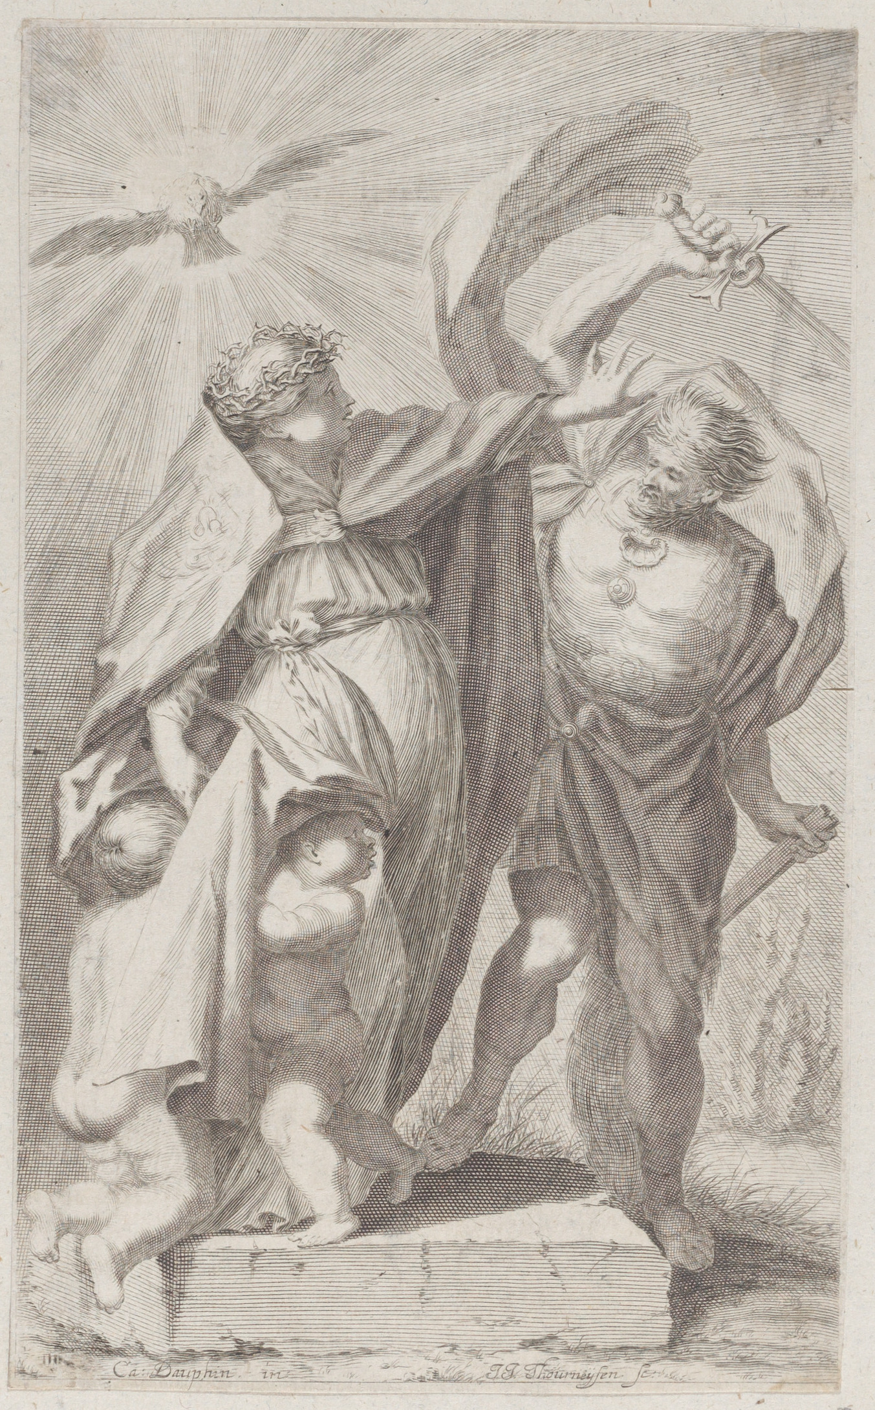
Notes:
Allegory of the church
Johann Jakob Thurneysen, the Elder Swiss
After Charles Claude Dauphin French
1652–1711
Met Museum of Art

Slide 5
Augsburg Confession Article XXI
Latin
English (Triglotta)
De cultu sanctorum docent, quod memoria sanctorum proponi potest, ut imitemur fidem eorum et bona opera iuxta vocationem
Of the worship of the Saints they teach that the memory of the saints may be set before us, that we may follow their faith and good works according to our calling.

Slide 6
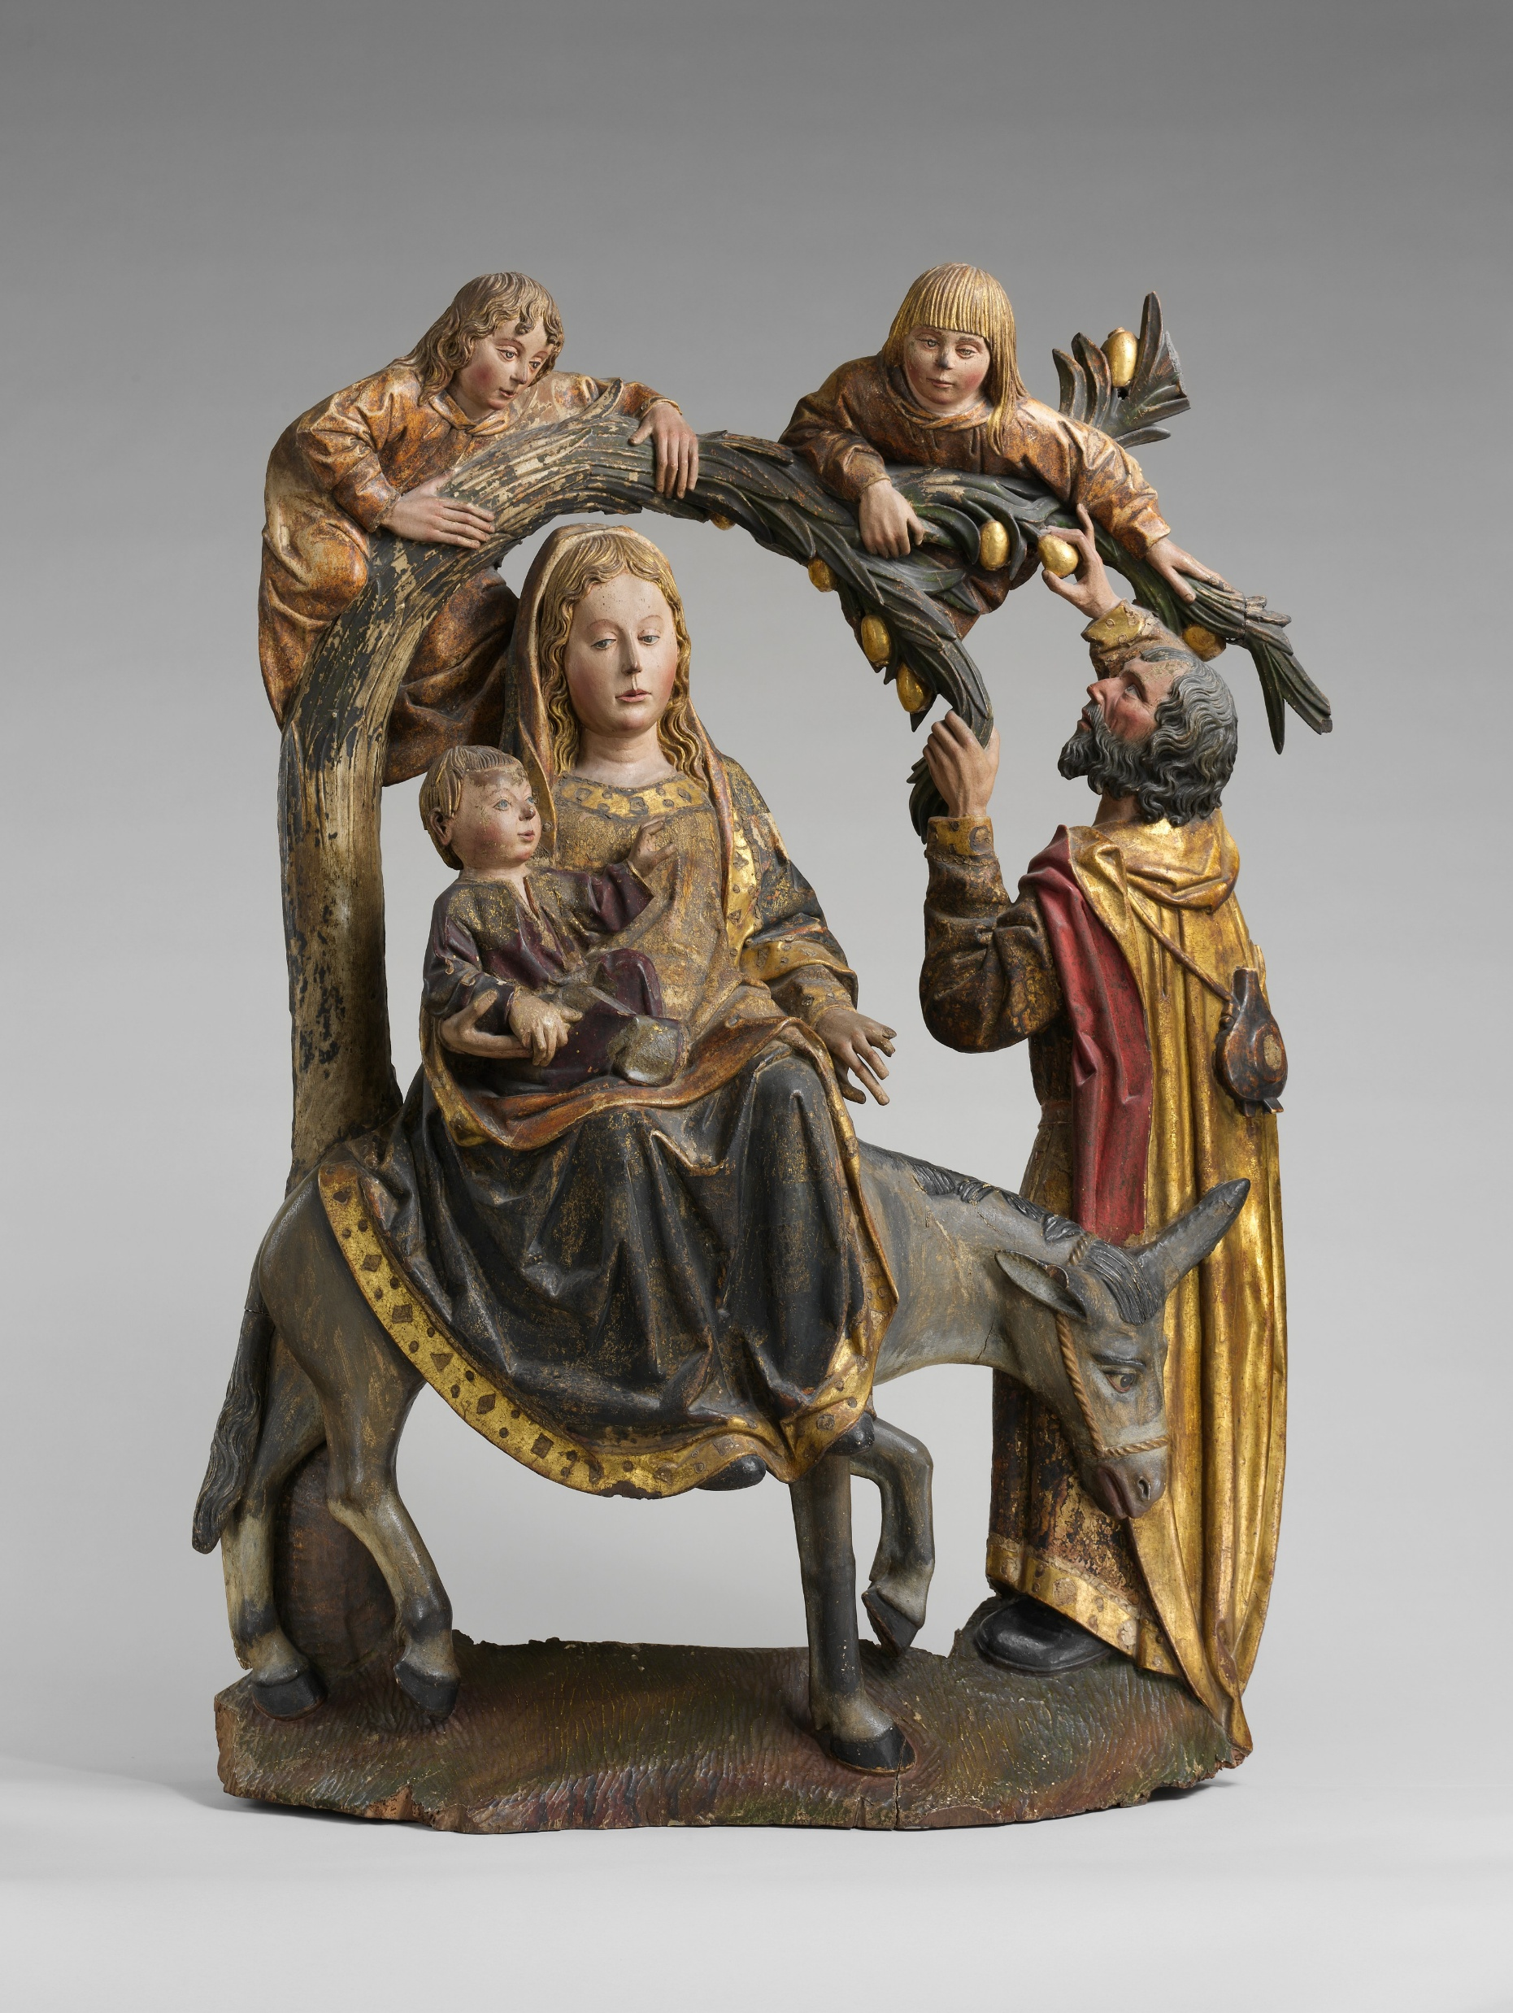
Roadmap
Lutheran Cult of the Saints
Historical Pitfalls
Practical Applications
Notes:
The Miracle of the Palm Tree on the Flight to Egypt
Spanish
ca. 1490–1510 On view at The Met Fifth Avenue in Gallery 305

Slide 7
Lutheran Cult of the Saints
II. Historical Pitfalls
III. Practical Applications

Slide 8
Threefold Honor
The first is thanksgiving. For we ought to give thanks to God because He has shown examples of mercy, because He has shown that He wishes to save men; because He has given teachers or other gifts to the Church. And these gifts, as they are the greatest, should be amplified, and the saints themselves should be praised (et laudandi ipsi sancti), who have faithfully used these gifts, just as Christ praises faithful business men (Matthew 25:21, 23).
The second service is the strengthening of our faith; when we see the denial forgiven Peter, we also are encouraged to believe the more that grace truly superabounds over sin, Romans 5:20.
The third honor is the imitation, first, of faith, then of the other virtues, which every one should imitate according to his calling.
AP XXI

Slide 9
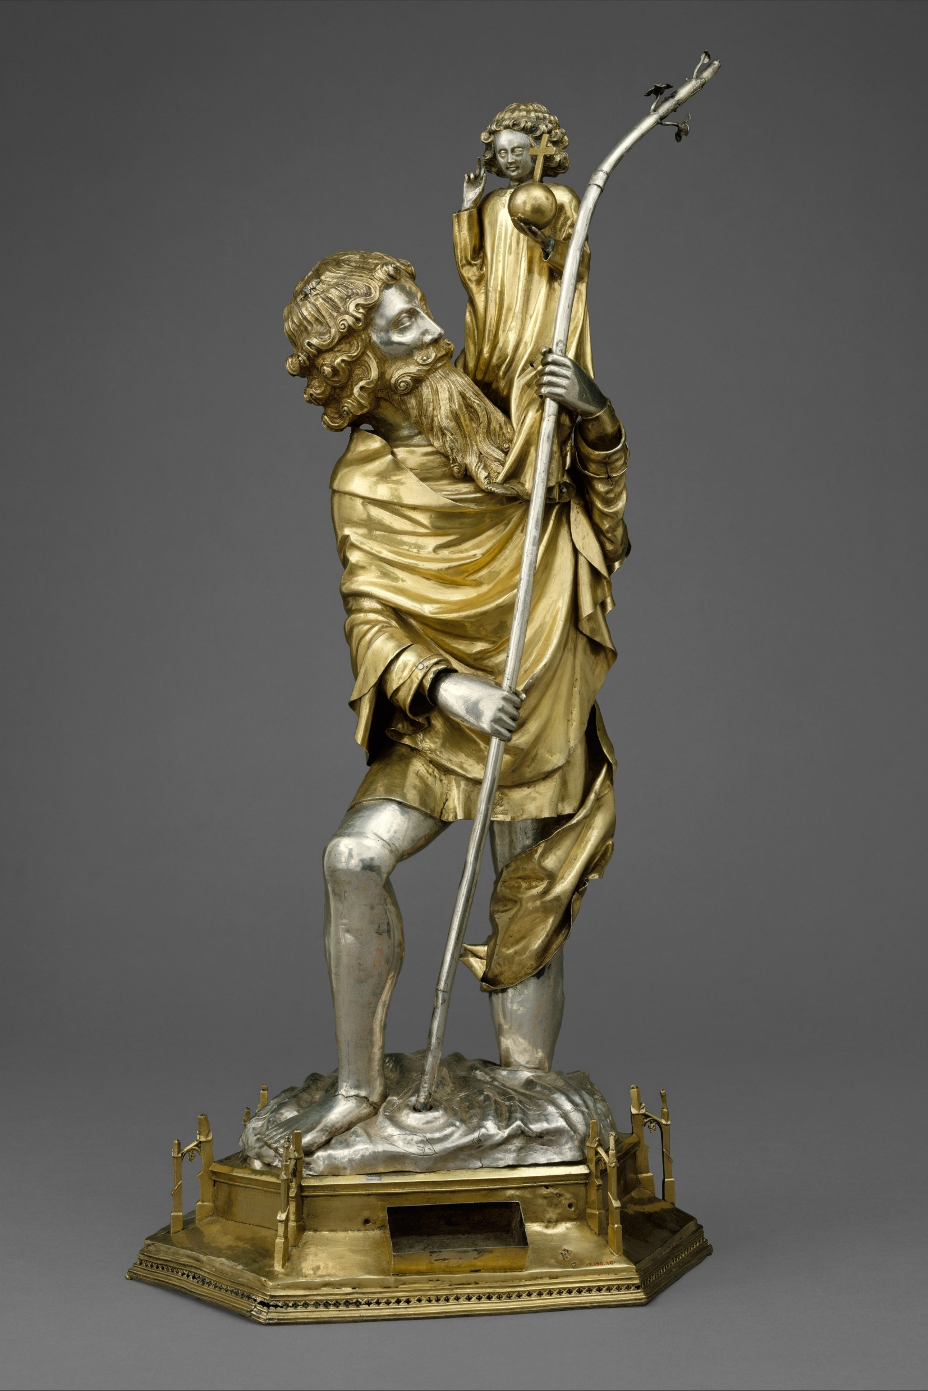
The Value of Fiction
Still the fabulous stories concerning the saints, which are publicly taught with great authority, surpass the marvelous tales of the statues and pictures. Barbara, amidst her torments, asks for the reward that no one who would invoke her should die without the Eucharist. Another, standing on one foot, recited daily the whole psaltery. Some wise man painted for children Christophorus, which in German means Bearer of Christ, in order by the allegory to signify that there ought to be great strength of mind in those who would bear Christ, i.e. who would teach or confess the Gospel because it is necessary to undergo the greatest dangers for they must wade by night through the great sea, i.e. endure all kinds of temptations and dangers. Then the foolish monks taught among the people that they ought to invoke Christophorus, as though such a Polyphemus had once existed.
Notes:
Reliquary Statuette of Saint Christopher
French
ca. 1375–1425 On view at The Met Fifth Avenue in Gallery 305

Slide 10
Historical Pitfalls
I. Lutheran Cult of the Saints
III. Practical Applications

Slide 11
Antinomianism
In regard to imitation

Slide 12
Sloth
In regard to study

Slide 13
Practical Applications
I. Lutheran Cult of the Saints
II. Historical Pitfalls

Slide 14
A Few Ideas
History Class
  Place of Hagiographies in historical context
    “Why are the Various Mary Days celebrated?
Literature Class
  Comparative Hagiography
    Read Eusebius, Caxton, and Foxe on a given saint.
Language Class
  Compare a section of Voragine with that of Caxton (Golden Legend)
  Find words like “propitiation” or “mediation” and look them up in the original text.

Slide 15
A Few Starting Places
Hagiography Proper
  Weedon, Celebrating the Saints
  Butler’s Live of the Saints
  Acts and Monuments Online (TAMO)
  Golden Legend (Caxton) full text in several volumes on archive.org
  The Sermons of Aelfric
Saints & Literature
  Joan Windham, Sixty Saints for Boys
  Geoffrey of Monmouth on King Arthur
  Fiction as “hagiography”
    LotR
    Chronicles of Narnia

